Slide 1
Evidence-Based Interventions
Tier 2 and Tier 3

Slide 2
Learning goals
Understand the importance of “evidence based”
Know how to define/identify an intervention
Understand the difference between Tier 2 and Tier 3 interventions
Identify 1 or 2 goals for improving student growth at Tier 2 and Tier 3
Create an action plan for improving student growth at Tier 2 and Tier 3
Notes:
Read through each bullet so participants understand the purpose of this module.

Slide 3
What is “Evidence based”?
Educational practices/instructional strategies supported by relevant scientific research studies
Notes:
This is a definition from the National Center of Response to Intervention.
Paraphrase in your own words.

Slide 4
What are interventions?
systematic and explicit instruction
provided to accelerate growth in an area of identified need
provided by both special and general educators
designed to improve performance relative to a specific, measurable goal
based on valid information about current performance
includes ongoing student progress monitoring
Notes:
This is a list of key words used to describe various interventions.

Slide 5
Tier 2

Slide 6
What is Tier 2?
Small-group instruction that relies on evidence based interventions that specify the instructional procedures, duration, and frequency of instruction
We know what to do but we struggle to understand how to do it!
Notes:
Many schools understand that Tier 2 requires time, staff, space and programs. They often lack these necessary resources. Encourage teams to think outside the box. Spending big bucks on fancy programs is not always the best answer.

Slide 7
Tier 2 : Strategic instruction
30-45 min. daily (can be + or -)
Smaller group
Typically in addition to the core
Targets specific skill deficits
Can be part of core, supplemental to the core, or both
Targets SOME students (approx. 10-20%)
Notes:
Taken from the Exploring Overview
Interventions can be as short as 5-10 min as long as they are skill specific to address their needs.

Slide 8
Tier 2: Supplemental, targeted instruction
Tier 2 is effective if at least 70-80% of students improve performance (i.e., gap is closing towards benchmark and/or progress monitoring standards).
Where are the students performing now?
Where do we want them to be?
How long do we have to get them there?
How much do they have to grow per year/monthly to get there?
What resources will move them at that rate?
Notes:
Information was presented by George Batsche during his presentation at MBI (2012).
Students at Tier 2 must move! They are not identified for life. If early intervention is identified and targeted, 70-80% of the students will begin to close the gap towards benchmark standards. These questions will help guide teams to identify the specific problem and prescribe the correct intervention needed.

Slide 9
Tier 2: Critical Issues
Purpose and expectation of Tier 2 services should be explicit and understood by all:
Increase performance of students relative to Tier 1 standards
Link curriculum content and strategies with Tier 1
Assess against Tier 1 expectations
70% of students receiving Tier 2 should attain proficiency
Notes:
Also taken from George Batsche (MBI, 2012).
School teams must remember that students at Tier 2 are still being held accountable for mastery of Tier 1 standards/expectations. With this level of support 70% will attain this goal and move back to the level of Tier 1 support by the end of the year.

Slide 10
Strategies vs. programs
Research based instructional strategies can be as effective as purchased programs at Tier 2
Strategies and programs can be combined to increase student growth
Notes:
Most schools use various instructional strategies at Tier I. Strategies can also be used at Tier 2 and Tier 3. For examples of strategies, see the following slide and matching handout created by Project REAL schools. A list of programs is available later in the presentation.
Fidelity to these programs and strategies is very important. If a teacher uses Think, Pair, Share but has modified the use of this strategy, fidelity may be in jeopardy. This would no longer qualify as a evidence based intervention.

Slide 11
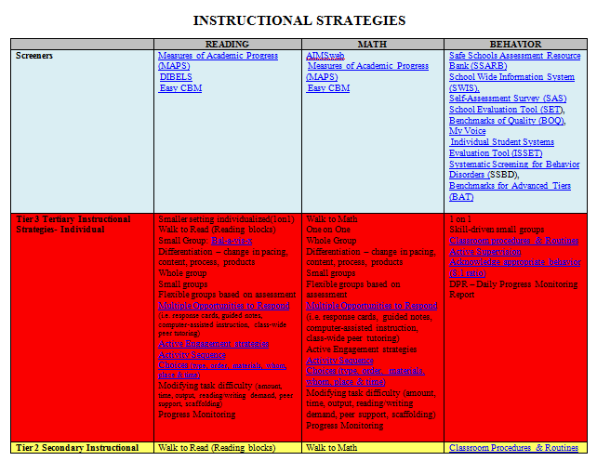
Examples: instructional strategies

Slide 12
Tier 3

Slide 13
Tier 3: Intensive, individualized Instruction
90-120 min. daily (+ or – as needed)
Small group or one on one
In addition to the core or using a replacement core
Targets skill deficits as per diagnostic screenings
Targets a FEW students (3-7%)
Notes:
Taken from Exploring Overview

Slide 14
Tier 3: Intensive, individualized instruction
Tier 3 is effective if there is progress (i.e., gap closing) towards benchmark and/or progress monitoring goals.
Where is the student performing now?
Where do we want him to be?
How long do we have to get him there?
What supports has he received?
What resources will move him at that rate?
Notes:
Same as slide for Tier 2. Students are expected to show growth that will close the gap towards benchmark goals. These questions will guide the team as they identify the deficit and prescribe an intervention.

Slide 15
Where do we begin?
Analyze your benchmark data
Analyze your outcome data
What does it say?
Identify 1 or 2 priority areas to get you started
Notes:
Here is an example: Example School was interested in developing a Tier 2 system with a focus on reading. We reviewed their reading benchmark data and found an interesting trend. Overall, students at the school were progressing quite well with general education instruction. More than 85% of the students were meeting proficiency targets with Tier 1 instruction alone. However, at this school, once a student was identified as at risk for poor reading outcomes, that student tended to remain in the at-risk category. In other words, the instructional program in place to support at-risk students was not effective. So for this school, it became clear that they had a strong core program and a consistent way to identify struggling students. What was needed was a Tier 2 instructional program that was more supportive of the needs of the students at risk for poor reading outcomes. (NCRTI)

Slide 16
Your Turn
Use your CRT data from last year and your benchmarking data from this year.
What does it say?
Identify 1 or 2 priority areas to focus on this year
Need help?
Facilitators are here to guide your discussions
Notes:
Many exploring schools have never been through this process before. Use the example from the previous slide to get them started. Facilitators should move to as many groups as possible to help them look at their data.
Allow up to 20 minutes for this activity.

Slide 17
Go a Step further
Can you identify students who may have received Tier 2 or Tier 3 services last year?
What does that data tell you about the growth of these students?
What generalizations can be made concerning your current Tier 2 or Tier 3 services?
Notes:
Teams may need another 15-20 minutes to talk through these questions.

Slide 18
Reflect
What challenges did you face with this activity?
What “aha’s” did your team experience?
Notes:
Ask each person to reflect individually for 2-5 minutes before sharing with their team. Then allow teams a few minutes to share with the whole group before moving on.
Possible challenges:
-Not sure who are Tier 2 or Tier 3 students
-Not ready for this activity yet
-Not enough time for this activity

Slide 19
3 components (Tier 2 and Tier 3)
Data Management system
Screening, progress monitoring & outcome data
Appropriate interventions
Intervention “team” who can run this system
Need Ideas? Look Here
http://www.rti4success.org/screeningTools/
http://www.rti4success.org/progressMonitoringTools/
Notes:
Data Management: There are many choices out there (DIBELS, AIMSweb, or even tracking within excel spreadsheets).They range from expensive to free. The key is to determine how your school will manage data for all types of assessments you will be using. Can your system manage all three? Data must be compiled and reviewed to make decisions that support continuous improvement. For many schools, a lot of data are collected, but there is no school-wide system for data evaluation and decision making.
Appropriate interventions: If your school benchmark data shows that decoding is a strength with your core program but your students are week in comprehension, use this to determine your interventions. Set your schedule and interventionists to work with programs that address comprehension, not decoding.
Exploring schools have already completed Curriculum Inventories in reading and/or math. Encourage them to use this tool to help them evaluate their current interventions. Where might they be in need of more resources?
Intervention team: Staff members (2 or more) who are working with Tier 2 students must understand how to use your data management system, how to use your various types of assessments, and how to effectively implement the programs or strategies needed for these students to be successful. The team meets on a regular basis to review data, problem-solve for students who are not making progress, and continue to refine their Tier 2 instruction so that it is highly effective for at-risk students.

Slide 20
Keys to success
Build a strong intervention team
Provide good professional development
Set clear procedures
Find sufficient resources
Communication is critical
Notes:
Many schools want to skip Tier 1 and begin working immediately on Tier 2. Tier 2 is just one part of a school-wide system. Careful planning is important to make each Tier an effective part of the overall system. Each item below will be addressed on the following slides.

Slide 21
Build a strong intervention team
Identify possible interventionists
Reading, math and/or behavior
Are they highly trained?
What resources are they lacking?
Materials, time, space, etc.
How can you provide good professional development?
Notes:
Allow 10 minutes for team discussions.

Slide 22
Clear Procedures
What decision rules will be used?
What will we do when students do not improve?
How will we determine if student progress is fast enough?
Are our procedures clearly expressed for all to follow?
For more information on decision rules, see page 9 of MTSS Implementation Components: Ensuring common language and understanding (in handouts folder)
Notes:
Allow 10 minutes for team discussions.

Slide 23
Find Sufficient resources
Have you allocated enough funds to allow Tier 2 to be successful?
Are there enough support staff, time and programs? What areas of reading, math and/or behavior do you need to increase program support?
Do you need to reallocated funds to increase student success?
Notes:
Allow 10 minutes for team discussions.

Slide 24
Communication
The intervention team will need to effectively communicate with classroom teachers, parents and students about successes and struggles.
How will we do this? Can we come up with some possible ideas?
Notes:
Allow 10 minutes for team discussions.

Slide 25
Document, Document, document!!!
The ARM Act (Administrative Rules of Montana) require full * documentation of 2 or more interventions before a student can be referred for special education testing.
* See RTI-E special ed form
Notes:
MT OPI

Slide 26
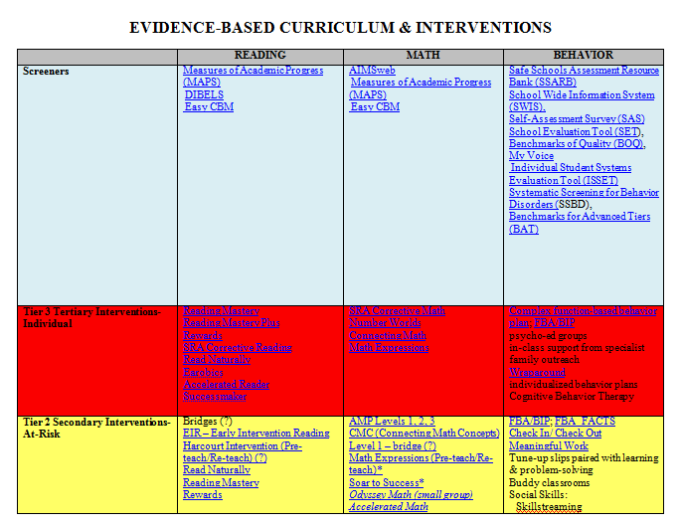
Examples: Programs
Notes:
Refer to updated handout from Project Real schools. Tier 2 programs are listed in yellow. Tier 3 programs are listed in red.
This is just a tool with a list of programs that schools around the state are currently using.
The electronic version is linked to descriptions of the interventions or core materials. Hopefully this will be a useful tool to help schools save time when researching evidence-based interventions.

Slide 27
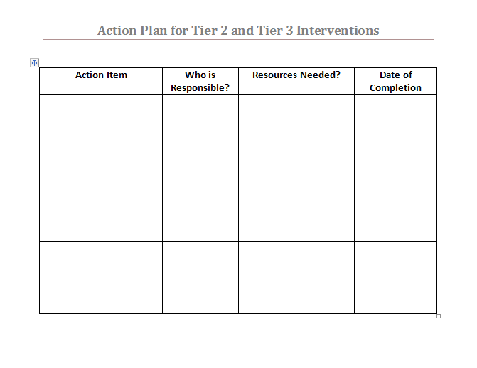
Create your action plan
Notes:
Give teams time to identify the work they need to complete to improve their Tier 2 and Tier 3 services. Facilitators can help teams fill in this form to be used by teams this year.

Slide 28
resources
How to Develop an Effective Tier 2 System, 2012, Evelyn Johnson, Ed.D., Associate Professor, Special Education, Executive Director, Lee Pesky Learning Center, Boise State University, NCRTI.
Integrating RtI and PBS Into a Single Multi-Tiered System of Supports (MTSS), Batsche, George M., Director of Institute for School Reform, University of South Florida, 2012. (MBI Presentation)

